Slide 1
Never Call Respondent’s Counsel a “Minion”
Ethics in Appellate Practice
Commissioner Michael E. Johnston
Washington State Supreme Court
Government Lawyers’ Bar Association Ethics CLE
December 14, 2018

Slide 2
First, the Small Print
The views expressed in this presentation are those of the presenter alone and should not be construed as official positions of the Washington Supreme Court and its individual justices, department heads, assistant department heads, staff attorneys, law clerks, externs, and anyone else working inside the Temple of Justice or within other judicial departments of Washington State’s judicial system and the Administrative Office of the Courts.

Slide 3
“Get Me Out of This!” – Warren Zevon, Lawyers, Guns, and Money
To appeal or not to appeal (or seek other form of review)
What are the chances of winning?
What are the risks of losing?
What are the unintended consequences of winning?
Attorney fees? RAP 18.1.
Sanctions? RAP 18.9.
Settle?

Slide 4
RPC as a Guardrail
Provide client with informed understanding of client’s legal rights & obligations. RPC Preamble [2].
Abide by client’s decisions concerning objectives & consult on means of pursuing objectives, including settlement. RPC 1.2(a).
Independent judgment & candid advice. RPC 2.1

Slide 5
A Really Long Guardrail
Communication – RPC 1.4(a)
Promptly inform client about decisions and circumstances requiring informed consent
Reasonably consult about means to obtain objectives
Keep client reasonably informed of case status
Consult about relevant RPC limitations to representation
Promptly comply with client’s requests for information

Slide 6
That is Unyielding
Effective Communication – RAP 1.4(b)
Explain the matter to the extent reasonably necessary to permit the client to make informed decisions regarding the representation

Slide 7
“Do not cross the streams. . . .
It would be bad.” – Ghostbusters (1984)
Do not blow up your case by . . .
Missing filing deadlines - RAP 18.8 (Beckman)
Failing to preserve & perfect the record
Inadequately briefing your arguments

Slide 8
Bombproof Your Case
Competent representation - RPC1.1
Legal knowledge: substantive and procedural
“It’s called discovery!” – My Cousin Vinny
Skill: seamless delivery of theory of case
“Next chart!” – Gen. Norman Schwarzkopf
Thoroughness: addressing all issues that matter
“Get the Windex, do a good job.” – Pulp Fiction
Preparation: anticipating questions and counterargument
“I must kill many men today.” – Seven Samurai

Slide 9
And Make it Bulletproof
Diligence – RPC 1.3
Reasonable diligence and promptness
commitment and dedication to client’s interests
reasonable exercise of professional discretion
controlled workload
avoiding procrastination
carrying through to the end
“He disinfected the cards.” – The Odd Couple

Slide 10
“History does record . . .” – Ry Cooder (Ballad of Jesse James, The Long Riders)
If you say it’s in the record, it had better be there
If you attach a piece of paper to a pleading, it had better belong there
Supplemental records ≠ new evidence

Slide 11
“We invented Post-it Notes.” – Romy and Michelle’s High School Reunion
Candor toward the tribunal – RPC 3.3
False statement of fact or law
Failure to correct false statement

Slide 12
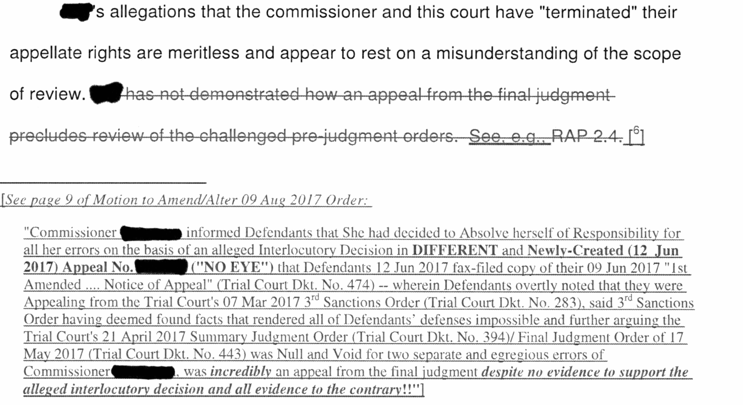
Cheekiness is Not Candor!

Slide 13
“But I do.”
– Shawn, I Tonya
More about candor . . .
Knowingly failing to disclose directly adverse legal authority. RPC 3.3(a)(3).
Duty to disclose directly adverse authority. Cmt [4]
Legal argument as a discussion on applicable law.

Slide 14
“Hey McFly! Your shoe’s untied.”
- Back to the Future
Fairness to Opposing Party - RPC 3.4
Fair competition
Professionalism
Collegiality
Not “hiding the ball”

Slide 15
“You’re a bad man!”
- It’s a Good Life (The Twilight Zone)
“Incompetent”
“Pharisee”
“Minion”
“Janissary”
but
“My learned friend”

Slide 16
“This aggression will not abide!”
- The Dude (The Big Lebowski)
Decorum - RPC 3.5
“That’s the stupidest thing I ever heard!”
“Hobson’s Choice order”
“Death penalty sanctions”
“Star Chamber”
“NJJ” (non-judge Johnston)

Slide 17
Judges are People Too
Code of Judicial Conduct (CJC)
Safeguarding an independent, fair, and impartial judiciary – Preamble [1]
thus
Judges shall act in a manner that promotes public confidence in judicial
Independence
Integrity
Impartiality
and
Avoid impropriety and appearance of impropriety – Canon Rule 1.2

Slide 18
“I better tell them who I am”
- Michael’s dinner date (1978)
Avoiding Abuse of Prestige of Judicial Office – CJC Rule 1.3
A judge shall not abuse the prestige of judicial office to
advance
the personal or economic interests of
the judge or
others or
allow others to do so

Slide 19
“Poverty Pimp”
- Washington Supreme Court Justice (2010)
Impartiality – Rule 2.2
Judge must be objective and open-minded – Comment [1]
Bias & Prejudice – Rule 2.3
Judge shall not manifest bias and prejudice – 2.3(B)
No “demeaning nicknames” – Comment [2]
Decorum & Demeanor – Rule 2.8
Judge shall be patient, dignified, and courteous

Slide 20
“Roadtrip!”
- Animal House
Ex Parte Communications – Rule 2.9
A judge shall not
initiate
permit or
consider
other communications made to the judge outside the presence of
the parties or
their lawyers
concerning a pending or impending matter.

Slide 21
“That’s the way they are!”
- 12 Angry Men
Manifesting prejudice or bias – RPC 8.4(h)
sex
race
age
creed
religion
color
national origin
disability
sexual orientation
honorably discharged veteran or military status
marital status

Slide 22
“Those people”
- Gen. Robert E. Lee
Examples. . .
Arguing certain judges beholden to religious authorities based on their law school
Calling petitioner’s counsel “New York lawyers”
Referring to transgender female petitioner as “Mr. ___.”

Slide 23
“Now, where was I?”
- Memento
Not every situation where a lawyer may encounter can be foreseen,
but fundamental ethical principles are always present as guidelines.
Within the framework of these principles,
a lawyer must with courage and foresight
be able and ready to shape the body of the law
to the everchanging relationships of society.
- Fundamental Principals of Professional Conduct

Slide 24
Any Questions?
“OK then!”
- Raising Arizona

