Slide 1
Impacts of SHB 1071: Protecting Personal Information
Kathryn Ruckle, J.D.
DSHS Privacy Officer
June 7, 2019

Slide 2
Substitute House Bill 1071
AGO request legislation for the 2019 legislative session
Title – Protecting Personal Information
To be codified at RCW 42.56.590 and RCW 19.255
Personal Information – Notice of Security Breaches
Passed Senate and House unanimously
Senate final passage - yeas, 46; nays, 0; excused, 3
House final passage – yeas, 96; nays, 0; excused, 2
Signed by Governor – May 7, 2019

Slide 3
Substitute House Bill 1071
Sections 1 through 4 apply to private industry and is codified under RCW 19.255
Sections 5 through 7 modifies 42.56.590 and applies to state and local governments

Slide 4
Substitute House Bill 1071
Main changes in legislation from current law:
Expands definition of Personal Information
Reduces time for notification of affected individuals from 45 days to 30 days
Reduces time for notification to the AGO to 30 days
Specifies more information that the AGO needs to be notified about (see Section 5(7)(a))

Slide 5
Expansion of Personal Information
Now-
Name in combination with:
After March 1, 2020-
Name in combination with:
SSN;
Drivers License # or WA ID #;
Full account number, credit or debit card number, or any required security code, access code, or password that would permit access to an individual's financial account.
SSN;
Driver's license # or WA ID #;
Account number, credit or debit card number, or any other security code, access code, or password that would permit access to an account;
Full date of birth;
Private key … that is used to authenticate or sign an electronic record;
Student, military, or passport ID #
Health insurance policy # or health insurance ID #;
Health information;
Biometric data;
User name or email address in combination with a password or security answers that permits account access

Slide 6
Deeper Dive into the law - PI is: An individual's first name or first initial and last name in combination with any one or more of the following data elements:
SSN;
Driver's license # or WA ID #;
Account number, credit or debit card number, or any other security code, access code, or password that would permit access to an account;
Full date of birth;
Private key … that is used to authenticate or sign an electronic record;
Student, military, or passport ID #
Health insurance policy # or health insurance ID #;
Health information;
Biometric data (see Chapter 19.375 RCW and Chapter 40.26 RCW);
User name or email address in combination with a password or security answers that permits account access*
*does not require first name/initial or last name combination

Slide 7
* Denotes Data Element Already covered by HIPAA
*SSN;
*Driver's license # or WA ID #;
*Account number, credit or debit card number, or any other security code, access code, or password that would permit access to an account;
*Full date of birth;
Private key … that is used to authenticate or sign an electronic record;
*Student, military, or passport ID #
*Health insurance policy # or health insurance ID #;
*Health information;
*Biometric data;
*User name or email address in combination with a password or security answers that permits account access†
† does not require first name/initial or last name combination

Slide 8
18 HIPAA identifiers:
(12) Web Universal Resource Locators (URLs)
(13) Internet Protocol (IP) address #s
(14) Biometric identifiers, including finger and voice prints
(15) Full face photographic images and any comparable images
(16) Any other unique identifying #, characteristic, or code (e.g. client ID)
(17) All geographic subdivisions smaller than a State
(18) All elements of dates (except year) for dates directly related to an individual, including birth date, admission date, discharge date, date of death
(1) Names
(2) Telephone numbers
(3) Fax numbers
(4) Electronic mail addresses
(5) Social security numbers
(6) Medical record numbers
(7) Health plan beneficiary numbers
(8) Account numbers
(9) Certificate/license #s
(10) Vehicle identifiers and serial numbers, including license plate numbers
(11) Device identifiers & serial #s

Slide 9
Breach Analysis
How do you identify a breach?

Slide 10
Breach Analysis - How do you identify a breach?
Look at what data elements were potentially compromised.
Who did the data go to?
How was the data obtained?
Was the data secured?
Mitigation.
Tip – Breach lingo 101 – All potential compromises of data should be referred to as an “incident” until you make the determination that “breach” has actually occurred. A breach is a legal determination that triggers required action under applicable laws.

Slide 11
Breach Analysis - How do you identify a breach?
Look at what data elements were potentially compromised.
Examples –
Was it full name and full SSN?
Was it last name and last four digits of SSN?
Was it name/address/passport #?
Was it health insurance ID number only and no other identifiers?

Slide 12
Breach Analysis - How do you identify a breach?
Who did the data go to?
Internal – 42.56.590(4) – Not changed in 1071
Good faith acquisition of personal information by an employee or agent of the agency for the purposes of the agency is not a breach of the security of the system when the personal information is not used or subject to further unauthorized disclosure.
This is not say that internal mis-use of data cannot be a breach. This gets to the “good faith” element

Slide 13
Breach Analysis - How do you identify a breach?
Who did the data go to?
External – Things to consider
Contractor – What do your contract terms say about treatment of data and notifications of breaches
Licensed professional (attorney or medical practitioner)
Former employee
Third party servers (e.g. yahoo email vs. State Government Network)

Slide 14
Breach Analysis - How do you identify a breach?
How was the data obtained?
Examples –
Mis-mailed
Mis-emailed
Stolen
Lost
Unauthorized access (“snooped”)
Unauthorized disclosure (can be verbal)
Improper disposal
Hacking/IT incident (includes ransomeware)

Slide 15
Breach Analysis - How do you identify a breach?
Was the data secured? – see definitions
"breach of the security of the system" means unauthorized acquisition of data that compromises the security, confidentiality, or integrity of personal information maintained by the agency. See 42.56.590(4)¹
“[S]ecured" means encrypted in a manner that meets or exceeds the national institute of standards and technology standard or is otherwise modified so that the personal information is rendered unreadable, unusable, or undecipherable by an unauthorized person. See 42.56.590(7)²
¹Note – This includes paper breaches
²Note – Check with your IT Security
These definitions did not change in SHB 1071. Same definitions that existed in the RCW since 2015.

Slide 16
Mitigation Actions in Response to Breach
Adopted encryption technologies | Changed password or strengthened password requirements | Created new/updated Security Rule Risk Management Plan
Implemented new technical safeguards | Implemented period technical and nontechnical evaluations | Improved physical security
Performed a new/updated Security Rule Risk Analysis | Provided contractor with additional training on security requirements | Provided individuals with free credit monitoring
Revised contract terms | Revised policies and procedures | Sanctioned workforce members involved (including up to termination)
Took steps to mitigate harm | Trained or retrained workforce members | Other Mitigation Actions

Slide 17
Breach Analysis - How do you identify a breach?
Risk of Harm analysis – in current and new law
“Notice is not required if the breach of the security of the system is not reasonably likely to subject consumers to a risk of harm.”

Slide 18
Notification
Reduces time for notification of affected individuals from 45 days to 30 days
Maintains the exception for compliance of HIPAA -notice in 60 days (See Sec. 6 in bill)

Slide 19
Notification Requirements – 1071
Plain language
Name and contact information of reporting agency
List of types of Personal Information exposed
“Timeframe of exposure” –
Date of breach and
Date of discovery of the breach
Toll-free numbers and addresses of the major credit reporting agencies

Slide 20
Delays for notification
Law enforcement
Notice may be delayed if notice would impede a criminal investigation (this determination must be made by the law enforcement agency)
Translation
An agency may delay notification to the consumer for up to an additional fourteen days to allow for notification to be translated into the primary language of the affected consumers.

Slide 21
Substitute Service of Notice
Substitute notice, if the agency demonstrates that the cost of providing notice would exceed two hundred fifty thousand dollars, or that the affected class of subject persons to be notified exceeds five hundred thousand, or the agency does not have sufficient contact information.

Slide 22
Substitute Service of Notice
Substitute notice shall consist of all of the following:
Email notice when the agency has an email address for the subject persons;
Conspicuous posting of the notice on the agency's web site page, if the agency maintains one; and
Notification to major statewide media.

Slide 23
Insufficient contact information
An agency that maintains its own notification procedures as part of an information security policy for the treatment of personal information and is otherwise consistent with the timing requirements of this section is in compliance with the notification requirements of this section if it notifies subject persons in accordance with its policies in the event of a breach of security of the system.

Slide 24
Methods of Notice
Written notice
Electronic notice (consumer must consent)
Substitute notice

Slide 25
Notice to AGO – If over 500
Must be within 30 days and include:
Number of Washington residents affected by the breach (or estimate if exact number is unknown)
List of type of PI exposed
“Time frame of exposure” (date of breach and date of discovery)
Summary of steps taken to contain breach (e.g. mitigation)
Sample copy of your notification letter
Updates to AGO required if any information is unknown at time notice is due

Slide 26
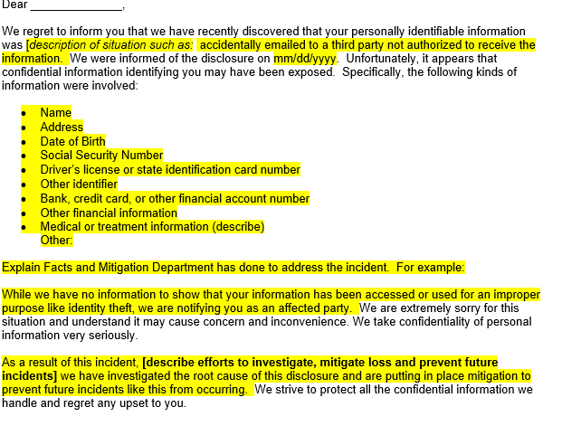
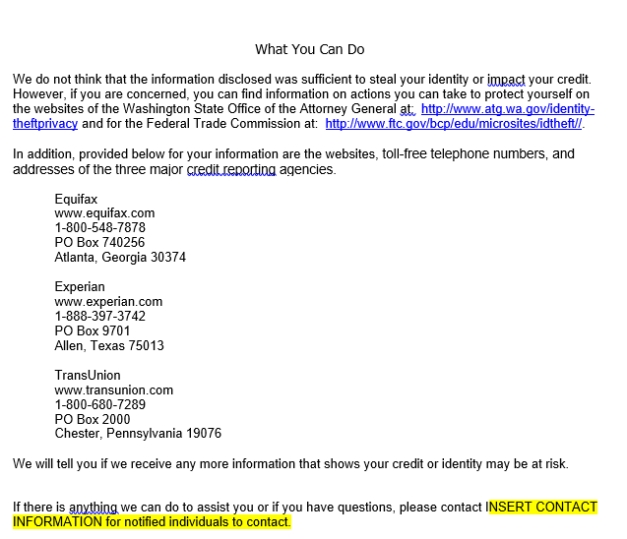
Sample Notice

Slide 27
This is new in SHB 1071 but does not apply to state and local government – only RCW 19.255
(d)(i) If the breach of the security of the system involves personal information including a user name or password, notice may be provided electronically or by email. The notice must comply with subsections (6), (7), and (8) of this section and must inform the person whose personal information has been breached to promptly change his or her password and security question or answer, as applicable, or to take other appropriate steps to protect the online account with the person or business and all other online accounts for which the person whose personal information has been breached uses the same user name or email address and password or security question or answer;
(ii) However, when the breach of the security of the system involves login credentials of an email account furnished by the person or business, the person or business may not provide the notification to that email address, but must provide notice using another method described in this subsection (4). The notice must… inform the person whose personal information has been breached to promptly change his or her password and security question or answer, or to take other appropriate steps to protect the online account with the person or business and all other online accounts for which the person whose personal information has been breached uses the same user name or email address and password or security question or answer.

Slide 28
This is new in SHB 1071 but does not apply to state and local government – only RCW 19.255
If user name and password compromised businesses can still notify by email but need to recommend individual change password or security questions and answers
However if login credentials are breached businesses CANNOT notify by email but still must notify by other approved method and recommend individual change password or security questions and answers
Also must recommend changing for all other online accounts you may use same email, password, and security questions and answers.

Slide 29
Consequences for Breaches

Slide 30
Consequences for Breaches
Violations of RCW 19.255 can result in violations of Consumer Protection Act (CPA) enforced by the AGO; CPA is not incorporated in 42.56.590 – however civil actions by individuals are allowed:
Any consumer injured by a violation of RCW 42.56.590 may institute a civil action to recover damages.
Any agency that violates, proposes to violate, or has violated RCW 42.56.590 may be enjoined.
The rights and remedies available under RCW 42.56.590 are cumulative to each other and to any other rights and remedies available under law.

Slide 31
Dilemmas with the new law
Public Records Act
Identity Theft

Slide 32
Dilemmas with the Public Records Act and 1071
Date of birth and driver’s license numbers are not exempt from disclosure under the Public Records Act in all cases, however, these are data elements that require notification if breached.
Law provides this exclusion for personal information:
“Personal information does not include publicly available information that is lawfully made available to the general public from federal, state, or local government records.”

Slide 33
Dilemmas with the Public Records Act and 1071
Example –
A public record request asks for contractor or bid documents and those records include a contractor’s driver’s license number.
DSHS does not have an exemption to redact that DL#
We no longer rely on 42.56.230(7)(a) based on Doe(s) v. Pierce County v. Zink (although it is an unpublished Div. II opinion Aug. 2018)
…RCW 42.56.230(7)(a), was intended to prevent the release of actual information submitted to the Department of Licensing. Additionally, in interpreting the PRA, we read its exemptions narrowly. Resident Action Council, 177 Wn.2d at 431. For these reasons, we interpret the personal information exemption, RCW 42.56.230(7)(a), as exempting only covered personal information actually submitted as part of an application for a driver’s license or identicard.

Slide 34
Identity Theft
Personal Information also means:
Any of the data elements or any combination of the data elements described in (a)(i) of this subsection without the consumer's first name or first initial and last name if:
(A) [it’s not encrypted] and
(B) The data element or combination of data elements would enable a person to commit identity theft against a consumer.

Slide 35
Summary of Concepts
Expansion of Personal Information definition
Breach Analysis – How do you identify a breach
Notification Requirements
Potential Consequences
Dilemmas with implementation

Slide 36
Questions
Kathryn Ruckle
DSHS Privacy Officer
dshsprivacyofficer@dshs.wa.gov
360-902-7802

